Slide 1

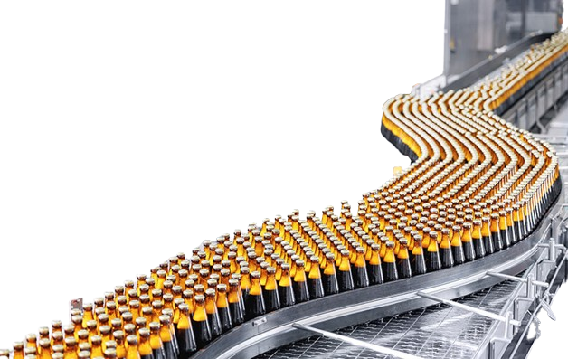

MANUFACTURING DOWNTIME ANALYSIS
A Look Into the Causing Factors, their Frequency, and patterns in a Beverage Factory.

Slide 2



PRESENTED BY:
Anas Ashraf Helmy
Fatma Abdelrahman Mahmoud
Farah Khaled Mostafa
Salwa Sayed Ibrahim
Manar Fathy Hassan
Rasha Mahmoud Hassan
2

Slide 3


INTRODUCTION
Project Objective:
-Analyzing manufacturing downtime data using Power BI to clarify the causes and improve production efficiency.
The importance of downtime analysis in improving production efficiency
What is Manufacturing Downtime?
3

Slide 4
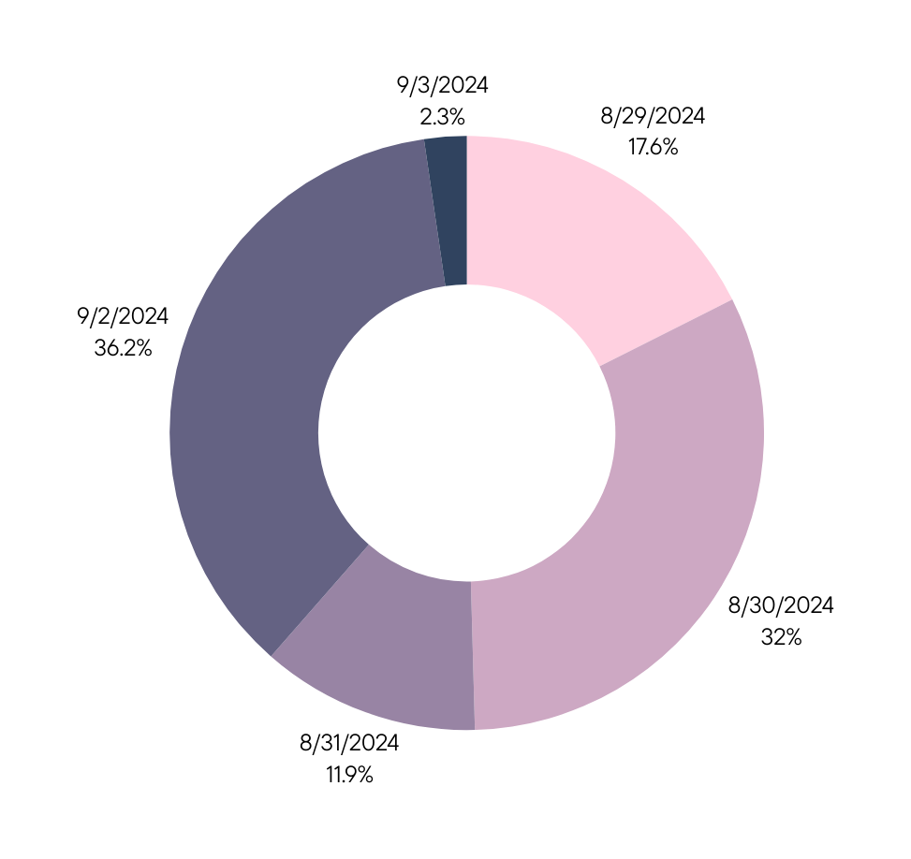
REFERENCE PERIOD
& DOWNTIME
The Data was based on a period of 5 days inside the Soda factory.
From 29\8\2024 to 3\9\2024
Downtime accounted for a total of 1388 minutes!
Our Analysis focused on the factors, their frequency and the underlying reasons of that!
4

Slide 5

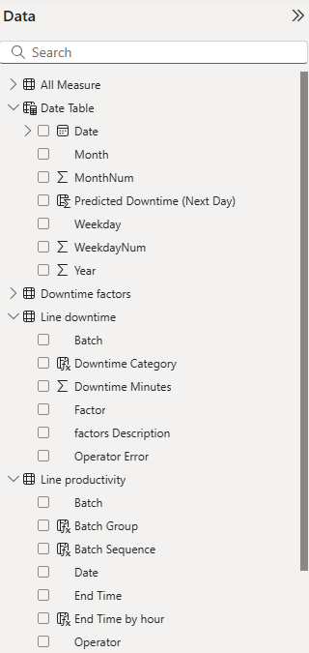
DATA USED
Production data
Downtime data
Causing factors data
Operators' data
KEY FIELDS
Date
Downtime
Duration
Production Duration
Contributing Factors
Responsible Operator
5

Slide 6

KEY ANALYTICAL QUESTIONS
What are the most frequent Downtime Factors?
What percentage of Total Production Time is Downtime?
How do different factors impact productivity?
What are the predicted Future Downtime Rates?
What are the Operators Contribution to the Downtime?
6

Slide 7

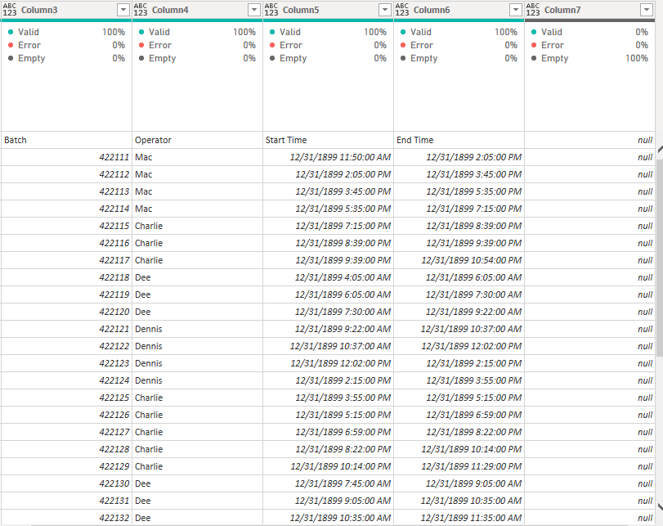
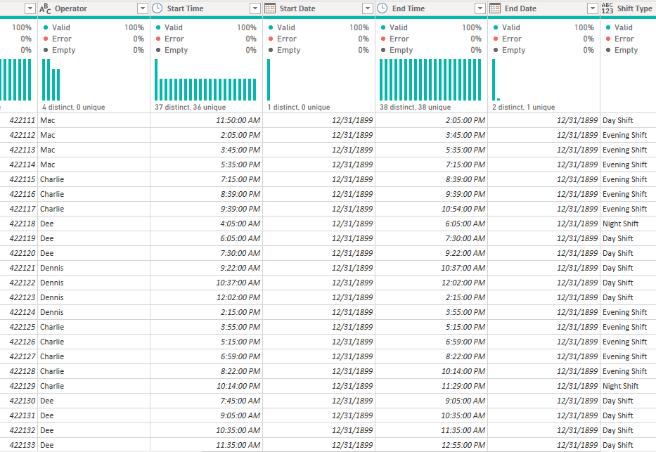
DATA CLEANING
BEFORE
AFTER
7

Slide 8
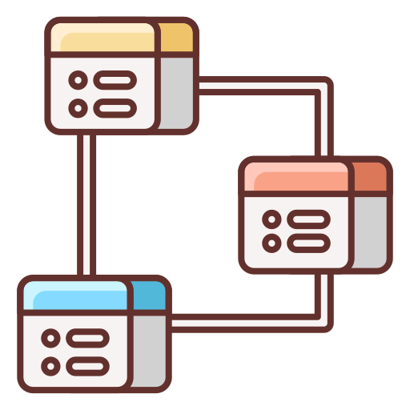
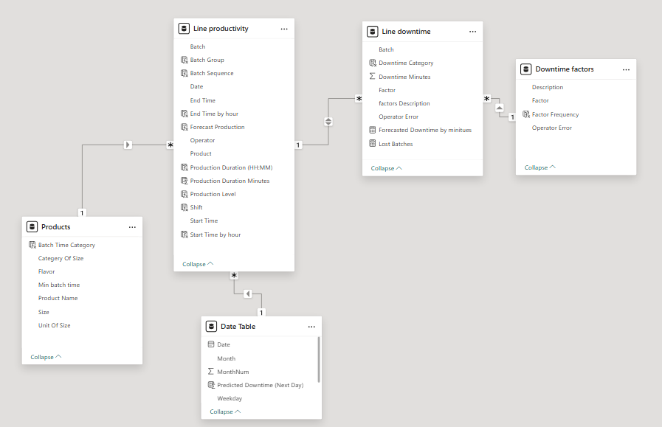
DATA MODELING
7

Slide 9


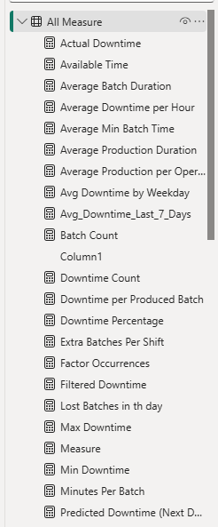
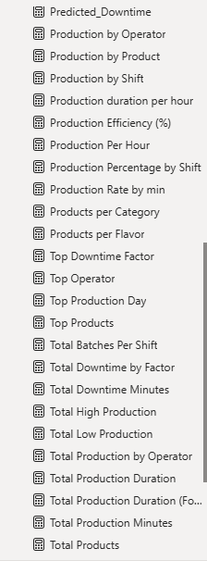
DAX & MEASURES
=GROUPBY(
=AVERAGE(
=IF(
=FORMAT(
=COUNT(
=TOPN(
=COUNTROWS(
=CONCATENATEX(
=CALCULATE(
=MAX(
=SUM(
=DIVIDE(
7

Slide 10







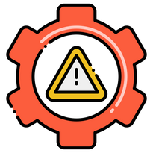

KEY
FINDINGS
Total Downtime
Downtime Percentage
Number of Factors
Percentage of Operators Errors
1388 Mins
1388 Mins
26.5%
12 Factors
32%
Active Production
Time
Production Efficiency
Number of Downtime Incidents
Predicted Downtime Percentage
3858 Mins
73.5%
61
22.7%

Slide 11


DASHBOARD
9

Slide 12

RECOMMENDATIONS
For a more efficient batch run
Enhance preventive measures to reduce unexpected downtimes.
Train operators to handle technical issues more efficiently.
Use predictive models to estimate future downtimes based on historical data.
Increase real-time monitoring of the production line, to detect faults before they occur.
10

Slide 13
THANK YOU FOR LISTENING!
Feel free to Ask any questions!

